Slide 1


MULTI-OBJECTIVE COST OPTIMIZATION IN PI CROSS-DOCK NETWORKS USING GENETIC ALGORITHMS
Master 2 Réseaux et système autonomes, paris cité
Presented by Zineb Taieb
Supervisors:
Mme Essghaier Fatma
M Allaoui Hamid
Motivation & context

Slide 2
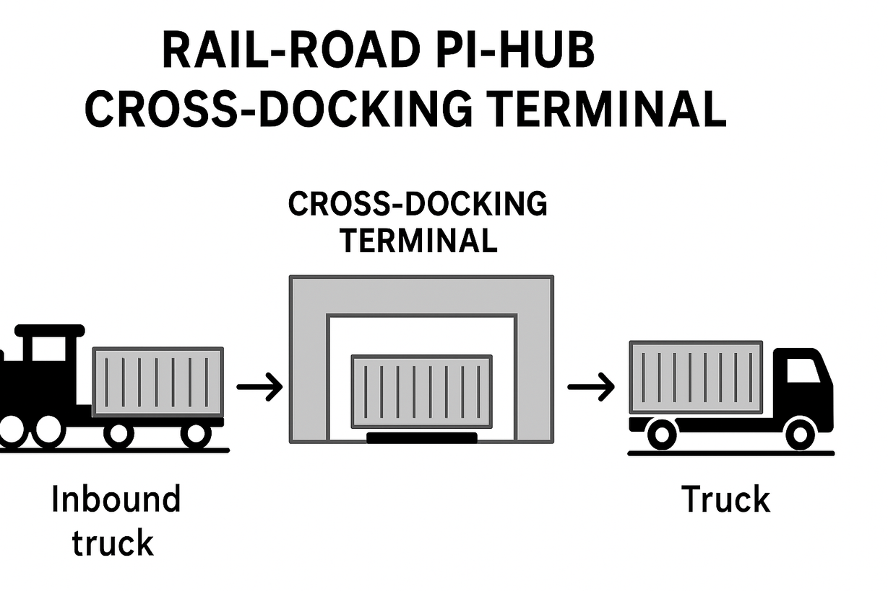
Motivation and context
WHY GA FOR CROSS DOCK OPTIMIZATION?
Objectif
We aim to optimize container-truck assignments to minimize transport cost and energy cost
NP-hard
Optimization of this kind of problems is NP-hard
Why Genetic algorithms?
Robustness, Adaptability, Flexibility(hybridization)

Slide 3

GENETIC ALGORITHM PRINCIPAL

Slide 4
CHROMOSOME DESIGN
Containers | 0 | Dock position | 0 | Containers | 0 | Dock position | 0 | Containers | 0 | Dock position | 0
[4] | 0 | 1 | 0 | [] | 0 | 2 | 0 | [1,2] | 0 | 4 | 0
Containers | 0 | Dock position | 0 | Containers | 0 | Dock position | 0
[3,6] | 0 | 3 | 0 | [] | 0 | 5 | 0
A chromosome represents a solution
Each block of 4 represents a truck and its assignements

Slide 5
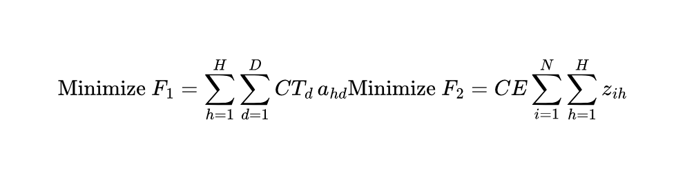
FITNESS FUNCTION
Shows how to evaluate each solution
Fitness function = Objective function
Weighted sum of F1 and F2 , with weights W1, W2
Fitness = W1* F1 + W2 * F2 ; W1=0.5 and W2=0.5

Slide 6
GENETIC OPERATIONS
Crossover
Flip a coin :
if random.random()< crossover_rate=0.9
Uniforme crossover
Parent 1 : [ [4,6],0,3,0, {Point de croisement}[1],0, 5 ,0,[],0, 1 ,0 ]
Enfant 1 : [ [4,6],0,3,0, [],0,7 ,0,[2],0, 6, 0 ]
Parent 2 : [ [3,7],0,4 ,0,{Point de croisement} [],0,7 ,0,[2],0, 6, 0 ]
Enfant 2 : [ [3,7],0,4 ,0, [1],0, 5 ,0,[],0, 1 ,0 ]
Else:
Enfant 1 =parent 1
Enfant 2 =parent 2
Mutate dock position
Chromosome : [ [4,6],0,5,0,[],0,3 ,0,[2],0, 1, 0 ]
Mutation
Chromosome : [ [4,6],0,3,0,[],0,7 ,0,[2],0, 6, 0 ]
Flip a coin :
if random.random()< mutation_rate=0.03:
Swap containers
Chromosome: [ [2],0,5,0,[],0,3 ,0,[4,6],0, 1, 0 ]

Slide 7

IMPLEMENTATIONS DETAILS
Run_ga(crossover_rate, mutation_rate, ratio_binpacking, num_elits).py
Utils.py( print_chromosome_assignments,
verify_solution_feasibility)
Generate_initial-population.py(
generate_random_chromosome
bonpacking)
Crossover
Mutation
Import
Import
Import
main.py
main GA loop
Crossover_rate | Mutation_rate | Ratio_binpacking | num_elits
0.9 | 0.03 | 0.8 | 1

Slide 8
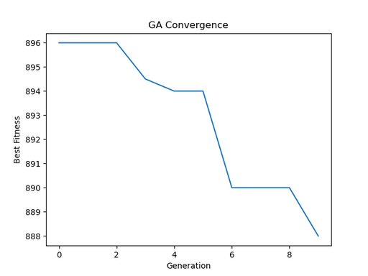
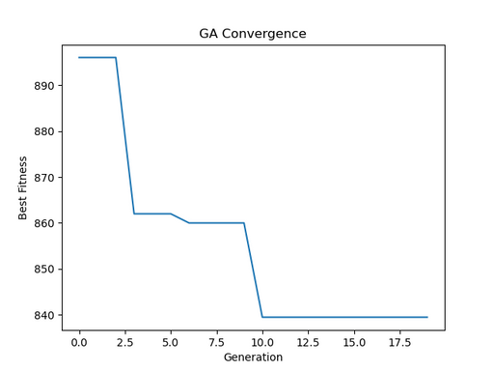
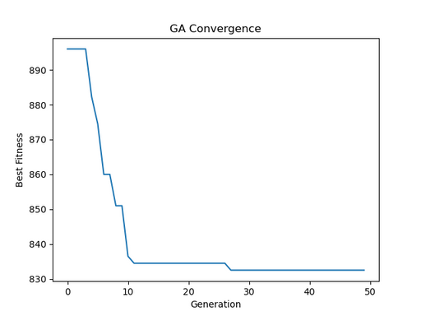
Convegence of the fitness evaluation
Experience | Population | Generations | temps d’execution (secon des) | Valeur Fitness
A | 10 | 10 | 58.405 | 888.0
B | 30 | 20 | 52.034 | 839.5
C | 100 | 50 | 92.124 | 832.5
Experience A
Experience B
Experience C
More population = more diversity

Slide 9
Convegence of the fitness evaluation
Mutation rate | Best fitnessue | Observation
0.05 | 880 | Bonne convergence, mais un peu lente
0.1 | 881 | Convergence plus rapide, mais pas plus optimale
0.07 | 877 | Meilleur équilibre : meilleure solution finale

Slide 10
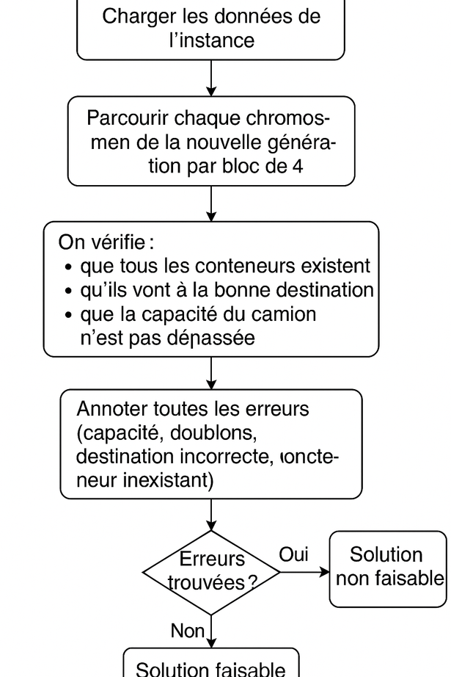
Feasible and unfeasible solutions
Feasable solution = solution that respects constraints ( truck capacity, destination and assignement)
Génération 1 :
Nouvelle population
Chromosome 1: [[], 0, 4, 0, [6, 3], 0, 4, 0, [1, 2], 0, 4, 0, [], 0, 5, 0, [4], 0, 3, 0] Chromosome 1 : Non faisable
Conteneur 6 (dest 2) assigné à camion 2 (dest 1) Conteneur 3 (dest 2) assigné à camion 2 (dest 1) Conteneur 4 (dest 1) assigné à camion 5 (dest 2)
Chromosome 5: [[], 0, 5, 0, [], 0, 3, 0, [1, 2], 0, 2, 0, [3, 6], 0, 4, 0, [], 0, 5, 0] Chromosome 5 : Faisable

Slide 11


Handling constraints and unfeasible solutions
Rejection strategy
Repair strategy
Penalize strategy
Penalize strategy
Fitness = W1* F1 + W2 * F2 + penalty
Problem with simple penalty
The GA minimizes : Fitness = W1* F1 + W2 * F2 + penalty
The GA found :
A chromosome with fewer containers → minimizes the total fitness
Penalty is small, GA prefers minimizing total cost over penalty.
Example output
Only 3 containers assigned out of 6, Penalty is weak

Slide 12
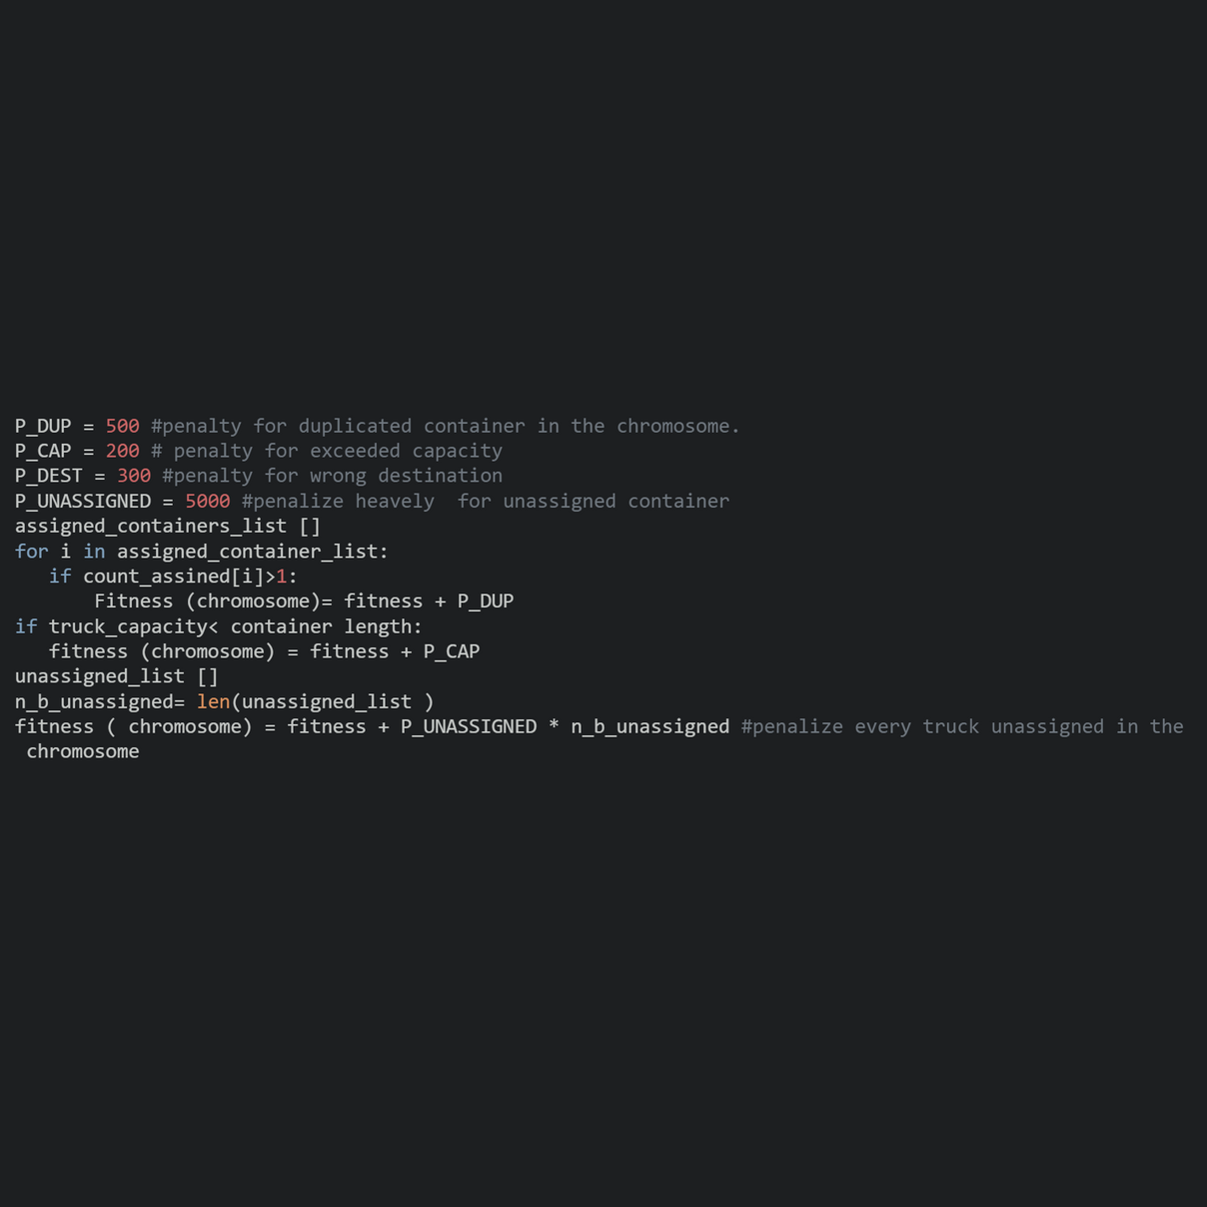
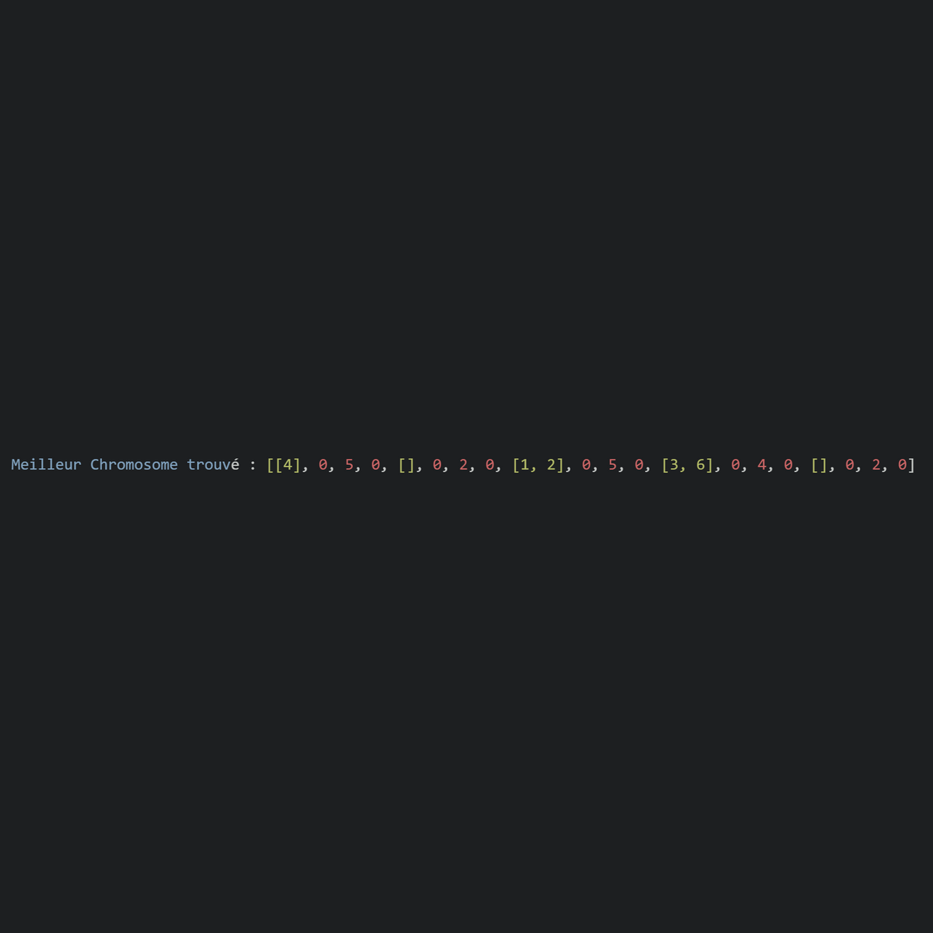
Handling constraints and unfisable solutions
Adaptative Penalizing strategy:
Penalize every container assigned more than once in the same chromosome
Penalize every container assigned to a truck with different destination
Penalize if truck capacity is exceeded
Penalize every unassigned container
Output of adaptative penalizing stategy
5 containers assigned, 1 unassigned container

Slide 13
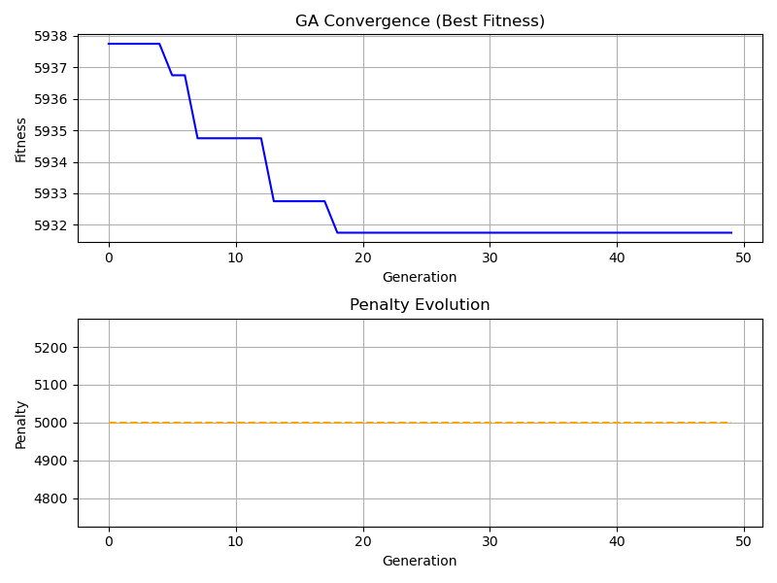
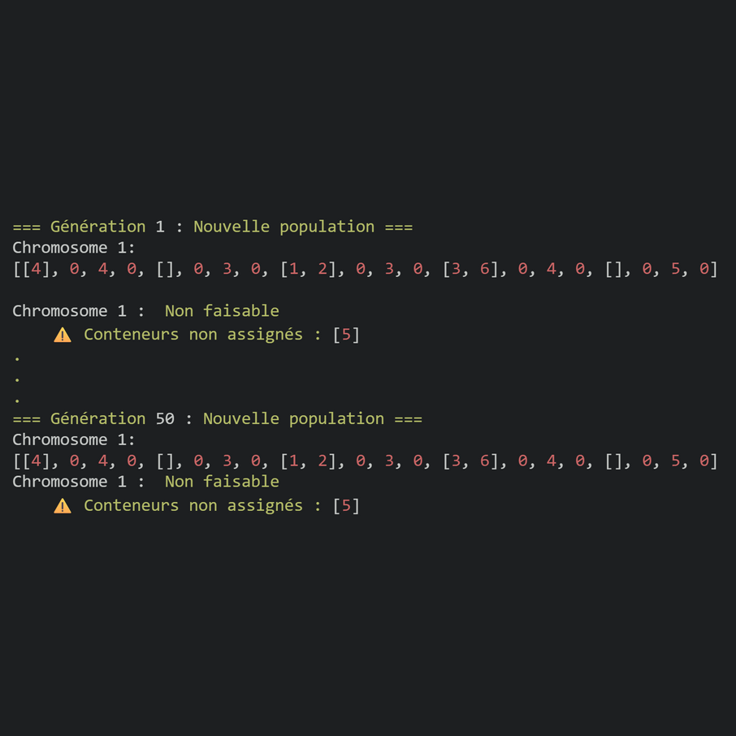
Results and discussions
Fitness convergence drops over the generations ⟶ normal
Penalty evolution over the generations stays flat = 5000⟶ the GA never get better with penalty, same penalty over the generations
Root cause:
Check Initial population:
⟶Container 5 never gets assigned
⟶Checking input data, Container[5].length = 10 > max truck capacity = 6

Slide 14
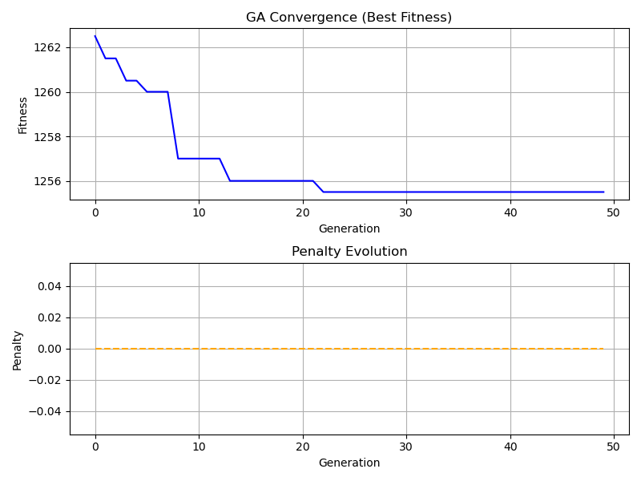
Results and discussions
After reinitialization:
Container[5].length = 5
Results
Fitness curve (top) : → Gradually decreases then stabilizes around generation 21.
Penalty curve (bottom) : → Perfectly flat at 0.
-->Meaning : every solution is feasible, no unassigned containers, no wrong destination and no capacity exceeded.

Slide 15

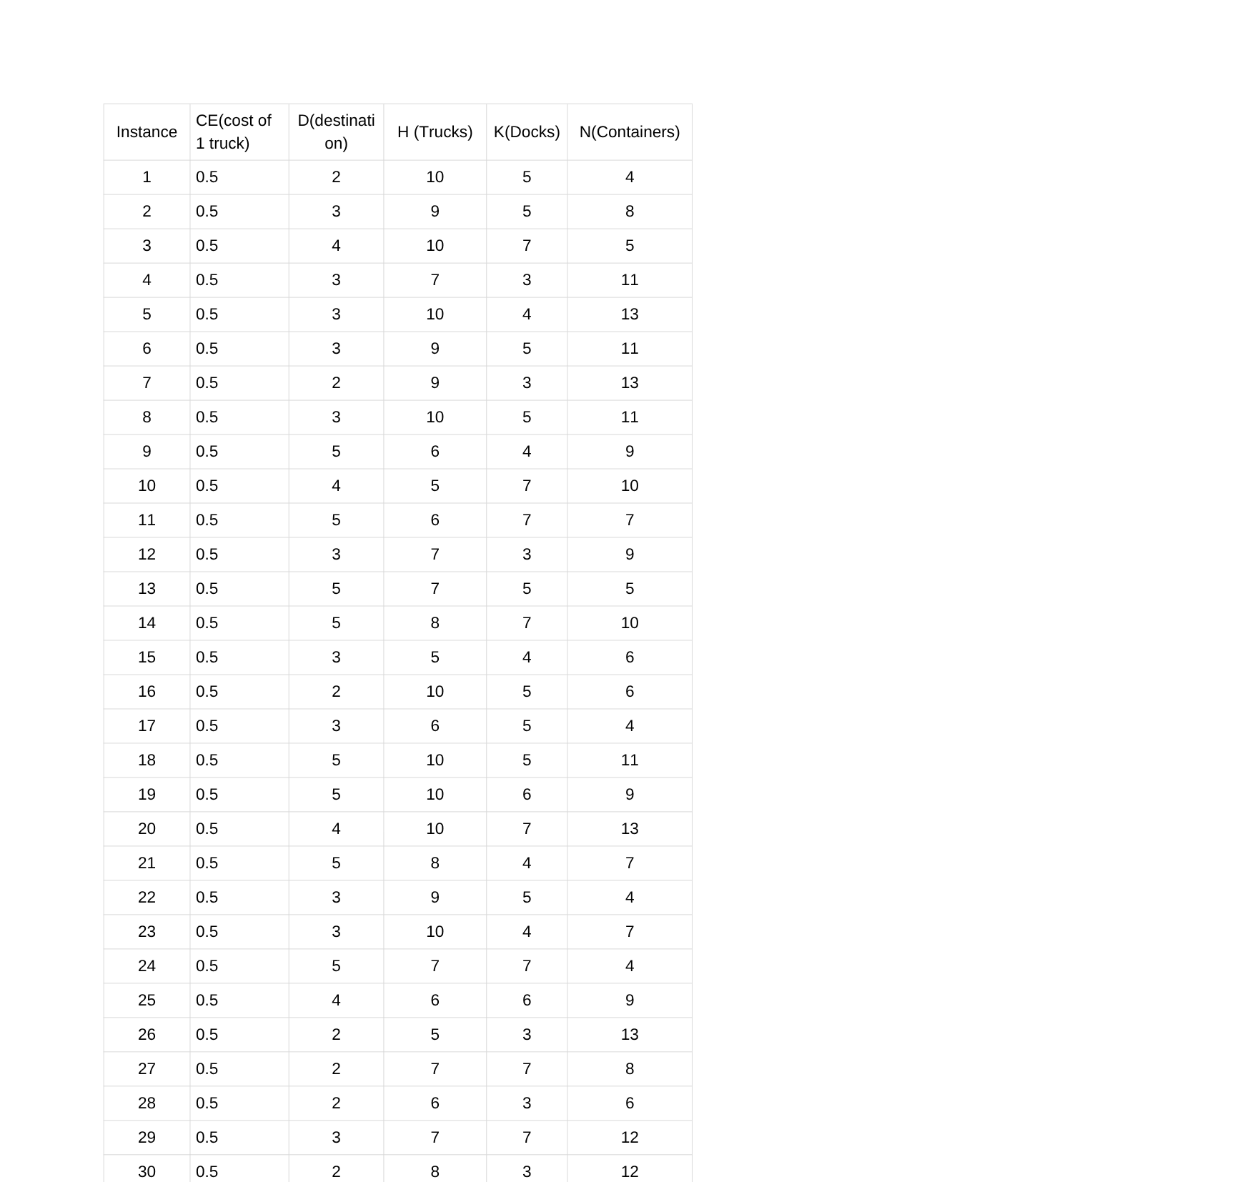
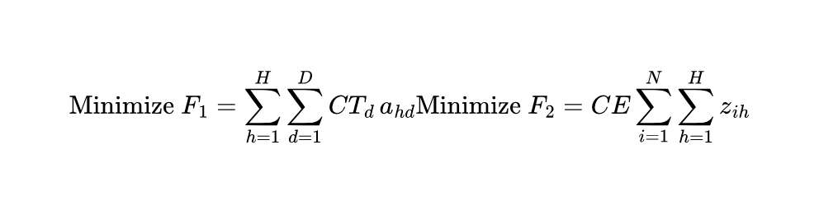
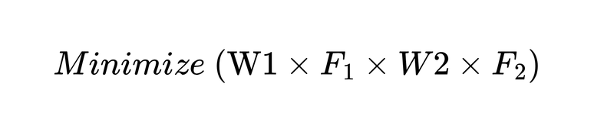
Exact Method
Instances
Instances param
Container_lengths[1, 2, 3, 4, 5]
Trucks size = 6
Cost_truck_by_dest
Cost_one energy_unit= 0,5
Optimize
Unified Objective function: Weighted Sum, W1=0.5 W2= 0.5
Gurobi License : Free academic license, version 12

Slide 16
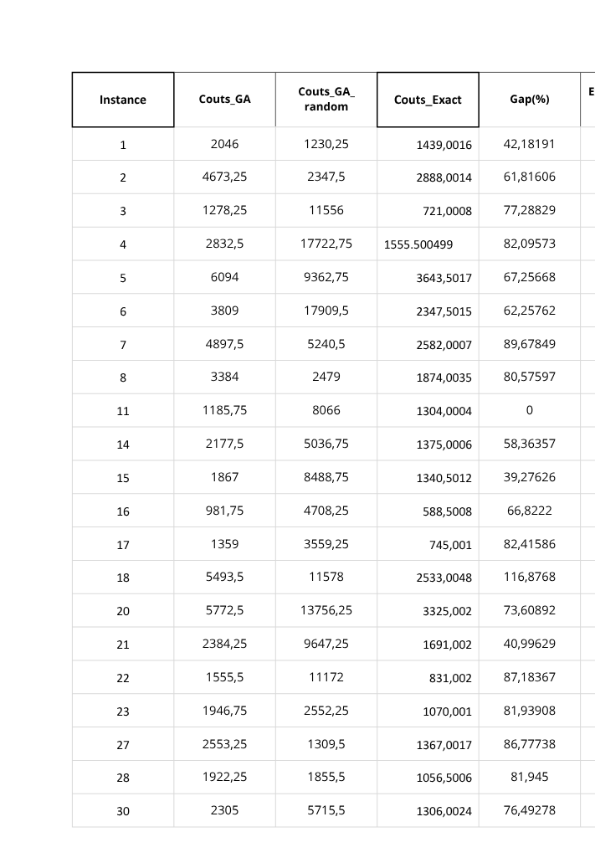
GA vs method_exact
Gap(%) = { 100 × (Couts_GA − Couts_Optimals)Couts_optimals, si Couts_GA > Couts_optimals
0, sinon
– Unsolved cases by Gurobi: 9, 10, 12, 13, 19, 24, 25, 26, 29 (status 3, infeasible).
– If Couts_GA> Couts_optimals, we measure the gap between Couts_GA and the optimal solution.
– If Couts_GA < Couts_optimals, Gap = 0, meaning the genetic algorithm found a more optimal solution than the exact method.
Execution time: for some instances, especially the larger ones, the exact method was very slow (up to 1056 seconds).
Ga with random initialization, significantly less stable, this indicates strong dependence of the GA on the initialization.

Slide 17
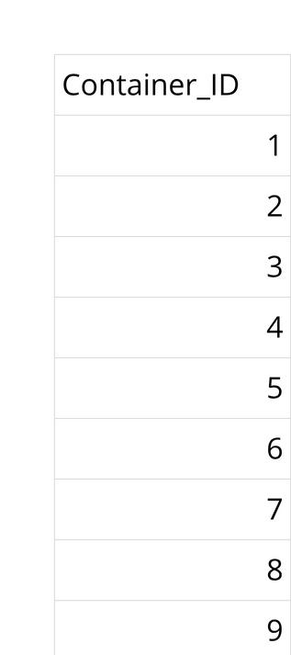
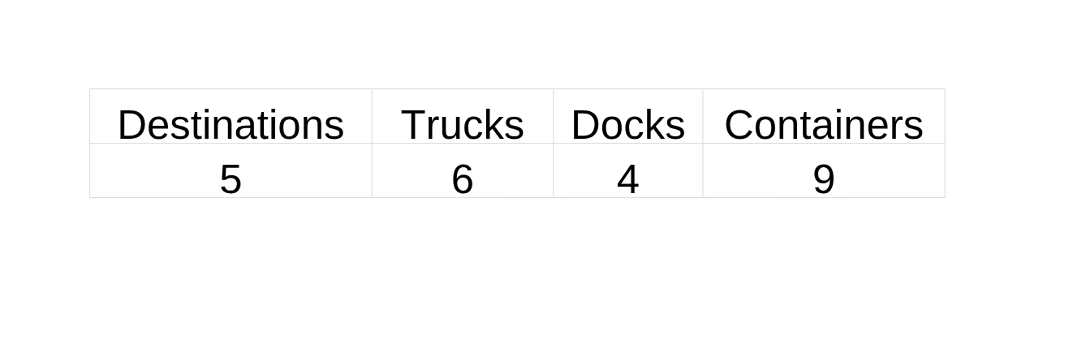
Instance 9 , noted unfeasible by Gurobi, let's see why?
Trucks_max_capacity =6
Constraints
One truck can only load containers with same destination
Containers (6, 7, 8) ->destination 3 ->3 trucks
Containers (3, 4) ->destination 5 ->1 trucks
Containers (5, 9) ->destination 2 ->1 trucks
7 trucks> 6 trucks
Containers (2) ->destination 4 ->1 trucks
Containers (1) ->destination 1 ->1 trucks

Slide 18
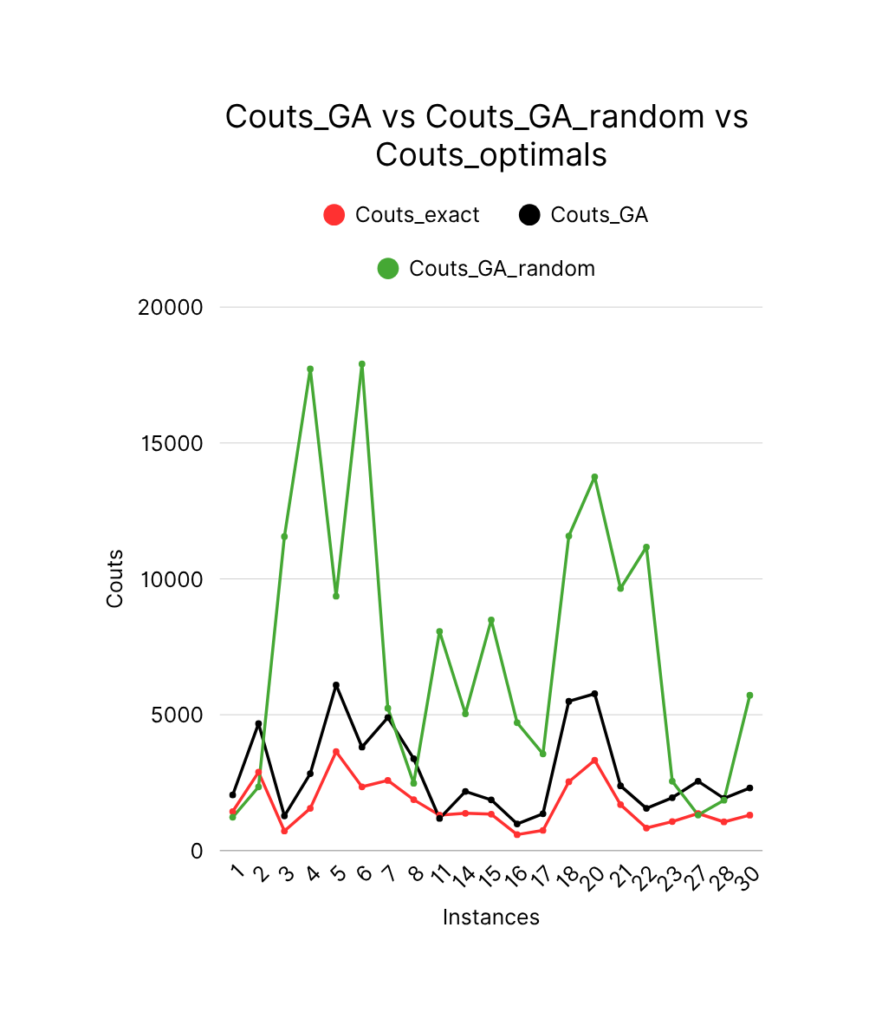

Slide 19
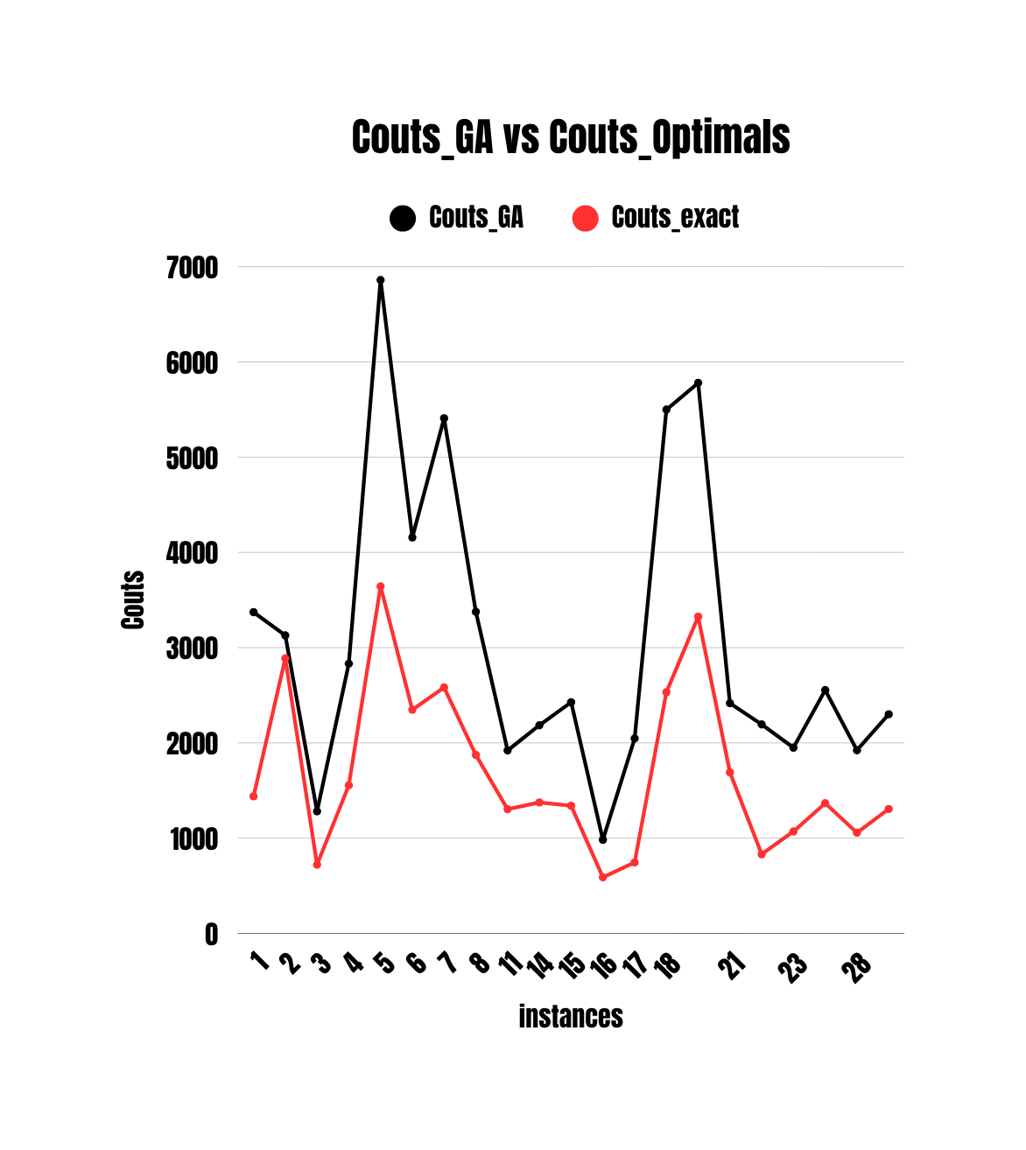
Notes:
L’algorithme génétique trouve des solutions quasi optimales pour les petites instances.

Slide 20
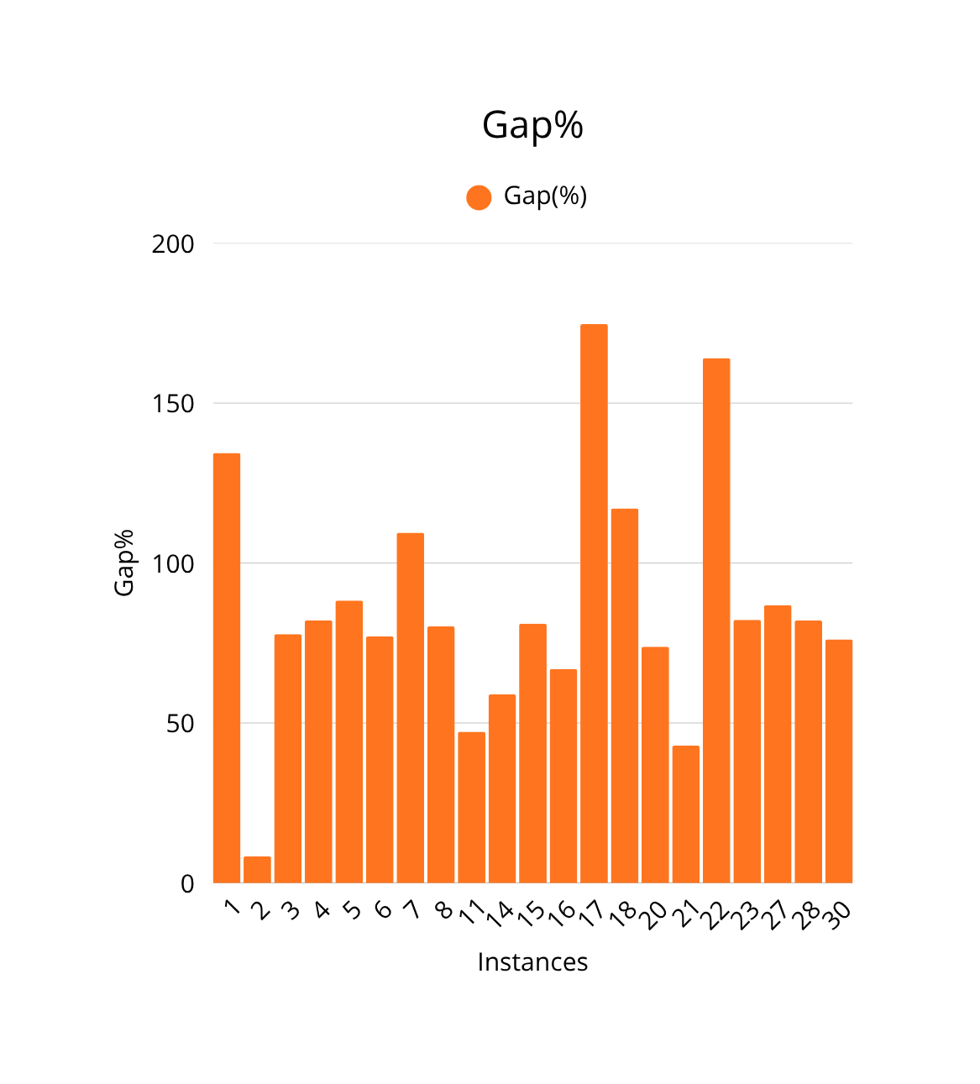

Slide 21
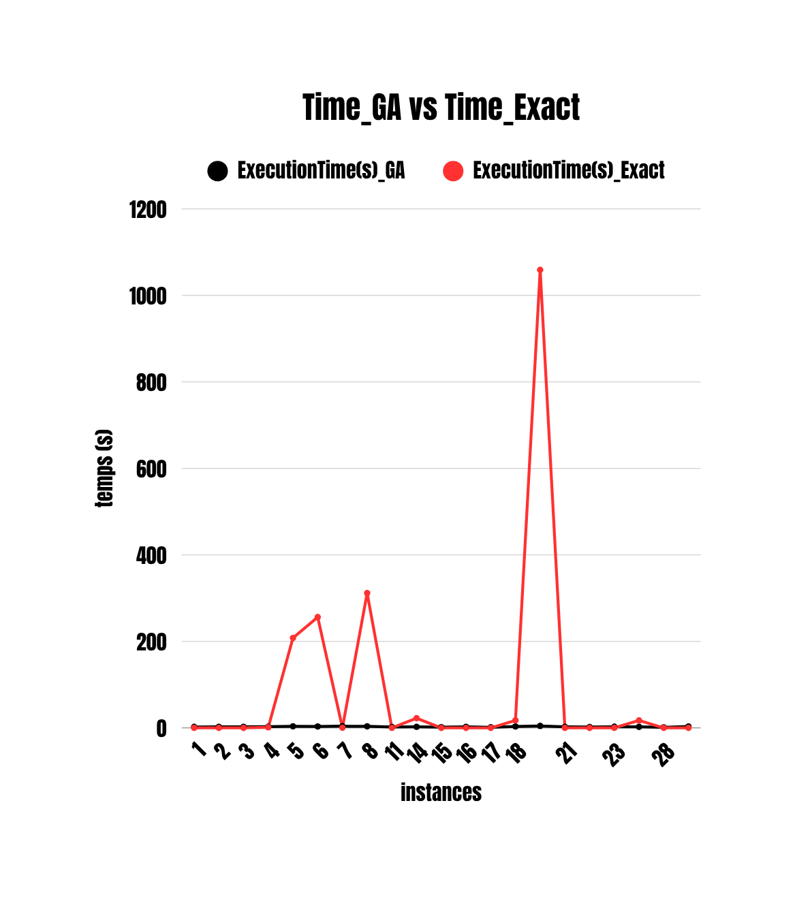
Notes:
L'algorithme génétique devient plus rapide mais moins précis sur les grandes instances.

Slide 22
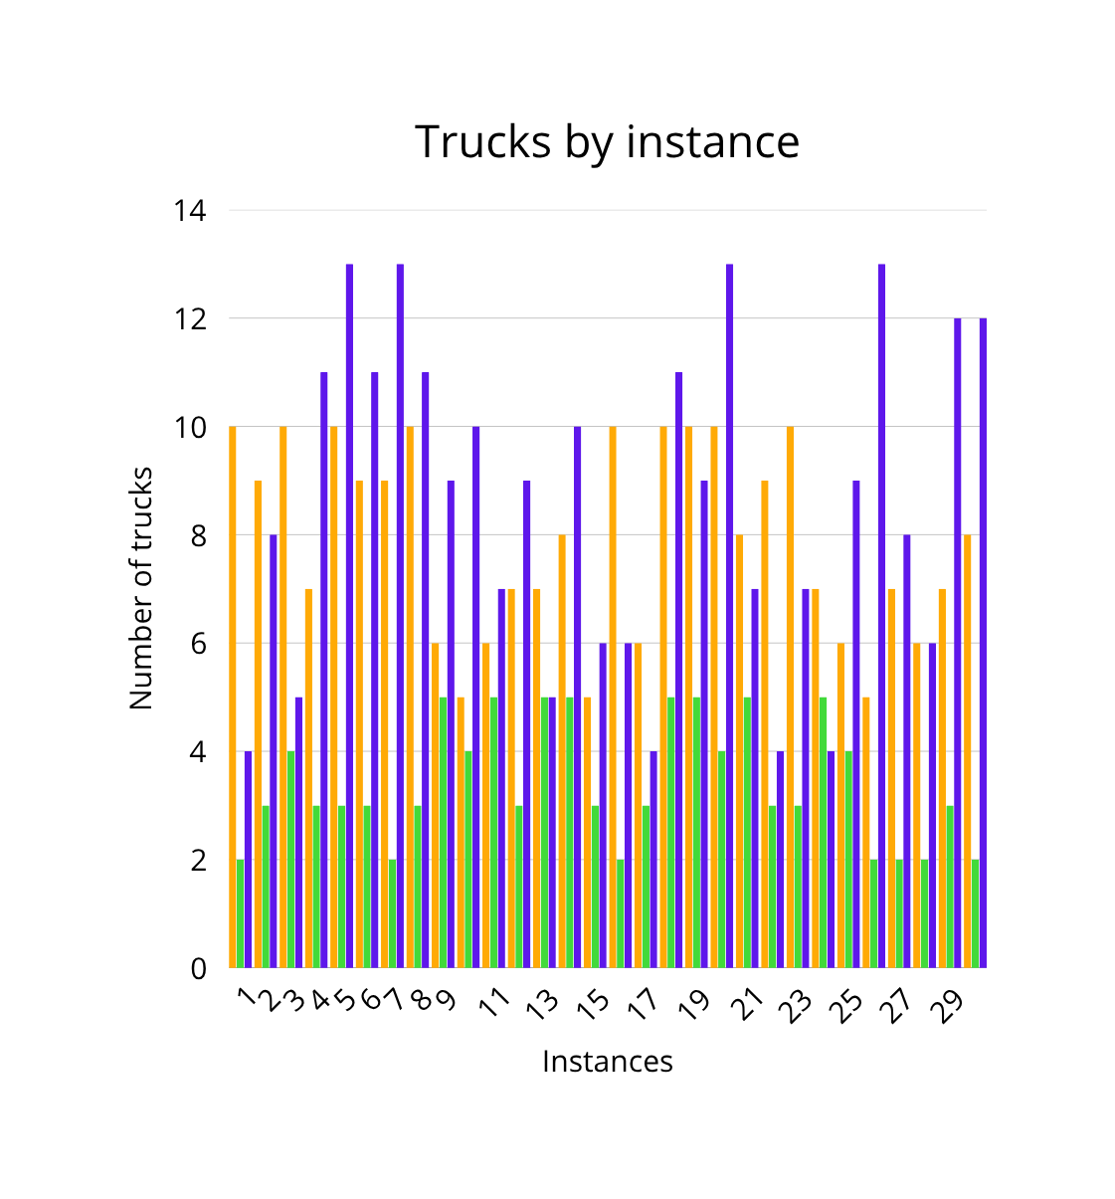
Notes:
Le paramétrage (mutation_rate, crossover_rate, taille population) influence fortement la faisabilité.

Slide 23
Conclusion & key improvements to explore next
Initial initialization plays a big role on the quality of the GA solutions
Big instances->GA faster-> Lose precision
Big instances->Exact_methode found optimal-> bigger time execution
Tradeoff (Optimal solutions, and Running time)
The results are still being stabilized, but the observed trends indicate that GA can provide a quick alternative, especially for large instances.
Move to Multi-Objective GA (NSGA-II)(Use NSGA-II to generate a Pareto front of best compromises)
Parameter tuning : population size, crossover rate, mutation rate, elitism.
Explore hybridized metaheuristics

Slide 24
Thank you

